Slide 1
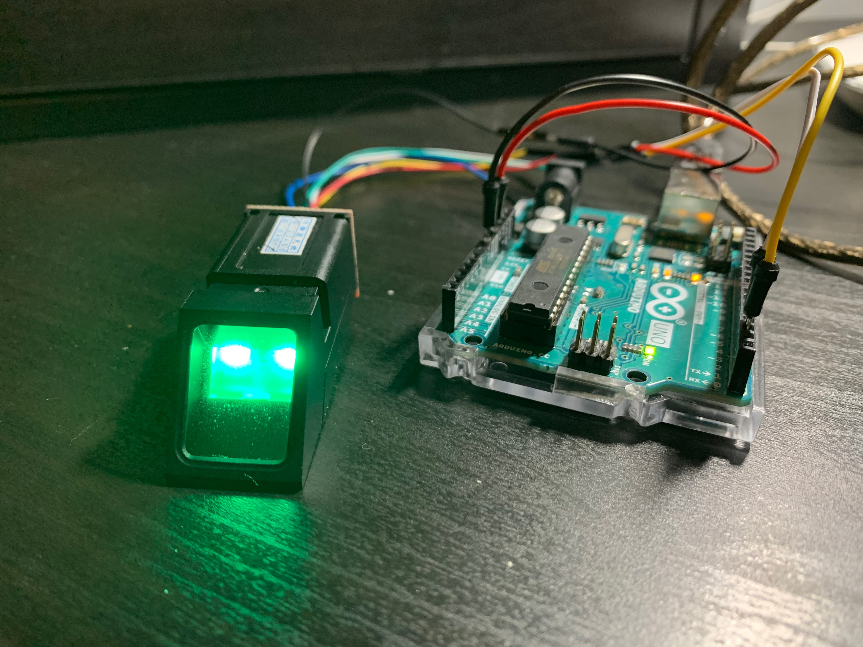
Fingerprint Sensor Setup
An optical fingerprint sensor is connected to Arduino UNO.
Arduino UNO is connected to laptop via USB for debugging/uploading and power supply.
Principles: Enroll 5 fingerprints.Verified by passing 3 of them.

Slide 2
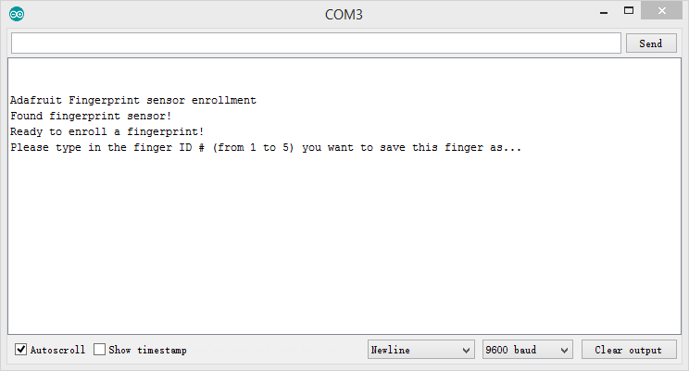

Slide 3
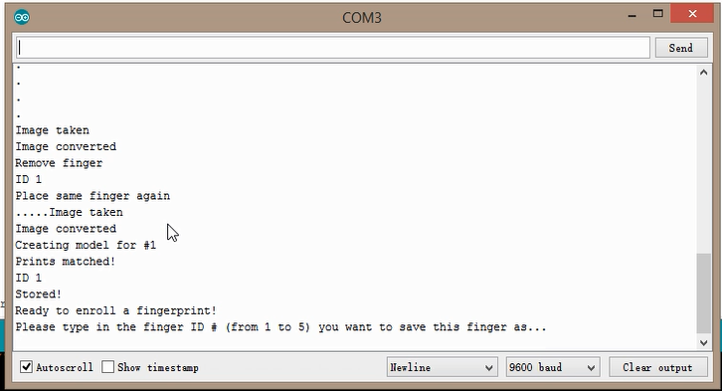

Slide 4
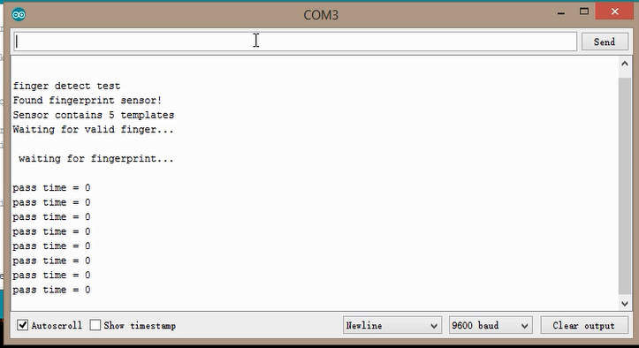

Slide 5
